Slide 1


Chapter 5
Decrease-and-Conquer
Copyright © 2007 Pearson Addison-Wesley. All rights reserved.

Slide 2
Decrease-and-Conquer
Reduce problem instance to smaller instance of the same problem
Solve smaller instance
Extend solution of smaller instance to obtain solution to original instance
Can be implemented either top-down or bottom-up
Also referred to as inductive or incremental approach

Slide 3
3 Types of Decrease and Conquer
Decrease by a constant (usually by 1):
  insertion sort
  graph traversal algorithms (DFS and BFS)
  topological sorting
  algorithms for generating permutations, subsets
Decrease by a constant factor (usually by half)
  binary search and bisection method
  exponentiation by squaring
  multiplication à la russe
Variable-size decrease
  Euclid’s algorithm
  selection by partition
  Nim-like games
  This usually results in a recursive algorithm.

Slide 4
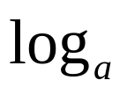
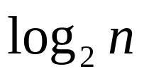
What’s the difference?
Consider the problem of exponentiation: Compute x^{n}
Brute Force:
Divide and conquer:
Decrease by one:
Decrease by constant factor:
n-1 multiplications
T(n) = 2*T(n/2) + 1
= n-1
T(n) = T(n-1) + 1 = n-1
T(n) = T(n/a) + a-1
= (a-1) n
= when a = 2
Notes:
Try to get the students involved in coming up with these:
Brute Force:
a^{n}= a*a*a*a*...*a
n
Divide and conquer:
a^{n}= a^{n/2} * a^{n/2} (more accurately, a^{n}= a^{⎣n/2⎦} * a ^{⎡n/2│})
Decrease by one:
a^{n}= a^{n-1}* a (one hopes a student will ask what is the difference with brute force here:
there is none in the resulting algorithm, of course, but you can arrive
at it in two different ways)
Decrease by constant factor:
a^{n}= (a^{n/2})² (again, if no student asks about it, be sure to point out the difference
with divide and conquer. Here there is a significant difference that leads to a
much more efficient algorithm – in divide and conquer we recompute a^{n/2}

Slide 5
Insertion Sort
To sort array A[0..n-1], sort A[0..n-2] recursively and then insert A[n-1] in its proper place among the sorted A[0..n-2]
Usually implemented bottom up (nonrecursively)
Example: Sort 6, 4, 1, 8, 5
6 | 4 1 8 5
4 6 | 1 8 5
1 4 6 | 8 5
1 4 6 8 | 5
1 4 5 6 8

Slide 6
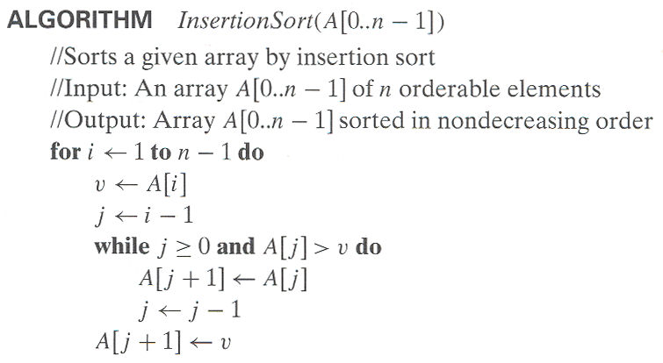
Pseudocode of Insertion Sort

Slide 7
Analysis of Insertion Sort
Time efficiency
C_{worst}(n) = n(n-1)/2 ∈ Θ(n²)
C_{avg}(n) ≈ n²/4 ∈ Θ(n²)
C_{best}(n) = n - 1 ∈ Θ(n) (also fast on almost sorted arrays)
Space efficiency: in-place
Stability: yes
Best elementary sorting algorithm overall
Binary insertion sort

Slide 8
Graph Traversal
Many problems require processing all graph vertices (and edges) in systematic fashion
Graph traversal algorithms:
  Depth-first search (DFS)
  Breadth-first search (BFS)

Slide 9
Depth-First Search (DFS)
Visits graph’s vertices by always moving away from last
visited vertex to an unvisited one, backtracks if no adjacent
unvisited vertex is available.
Recurisve or it uses a stack
  a vertex is pushed onto the stack when it’s reached for the first time
  a vertex is popped off the stack when it becomes a dead end, i.e., when there is no adjacent unvisited vertex
“Redraws” graph in tree-like fashion (with tree edges and
back edges for undirected graph)

Slide 10
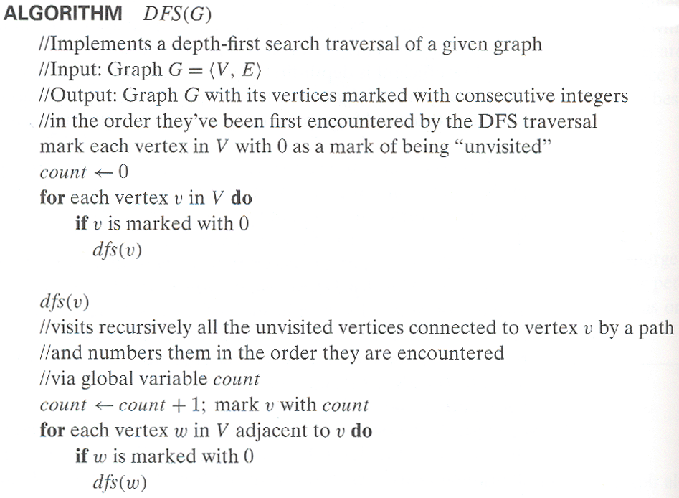
Pseudocode of DFS

Slide 11
Example: DFS traversal of undirected graph
a
b
c
d
a
ab
abf
abfe
abf
ab
abg
abgc
abgcd
abgcdh
abgcd
…
e
f
g
h
DFS traversal stack:
DFS tree:
1
2
6
7
a
b
c
d
e
f
g
h
4
3
5
8
Red edges are tree edges and white edges are back edges.
Notes:
Traversal using alphabetical order of vertices. Work through this example in detail,
showing the traversal by highlighting edges on the graph and showing how the stack
evolves:
8 h 3
7 d 4 stack shown growing upwards
4 e 1 6 c 5 number on left is order that vertex was pushed onto stack
3 f 2 5 g 6 number on right is order that vertex was popped from stack
2 b 7 overlap is because after e, f are popped off stack, g and c
1 a 8 are pushed onto stack in their former locations.
order pushed onto stack: a b f e g c d h
order popped from stack: e f h d c g b a
* show dfs tree as it gets constructed, back edges

Slide 12
Notes on DFS
DFS can be implemented with graphs represented as:
  adjacency matrices: Θ(|V|²). Why?
  adjacency lists: Θ(|V|+|E|). Why?
Yields two distinct ordering of vertices:
  order in which vertices are first encountered (pushed onto stack)
  order in which vertices become dead-ends (popped off stack)
Applications:
  checking connectivity, finding connected components
  checking acyclicity (if no back edges)
  finding articulation points and biconnected components
  searching the state-space of problems for solutions (in AI)

Slide 13
Breadth-first search (BFS)
Visits graph vertices by moving across to all the neighbors of the last visited vertex
Instead of a stack, BFS uses a queue
Similar to level-by-level tree traversal
“Redraws” graph in tree-like fashion (with tree edges and cross edges for undirected graph)

Slide 14
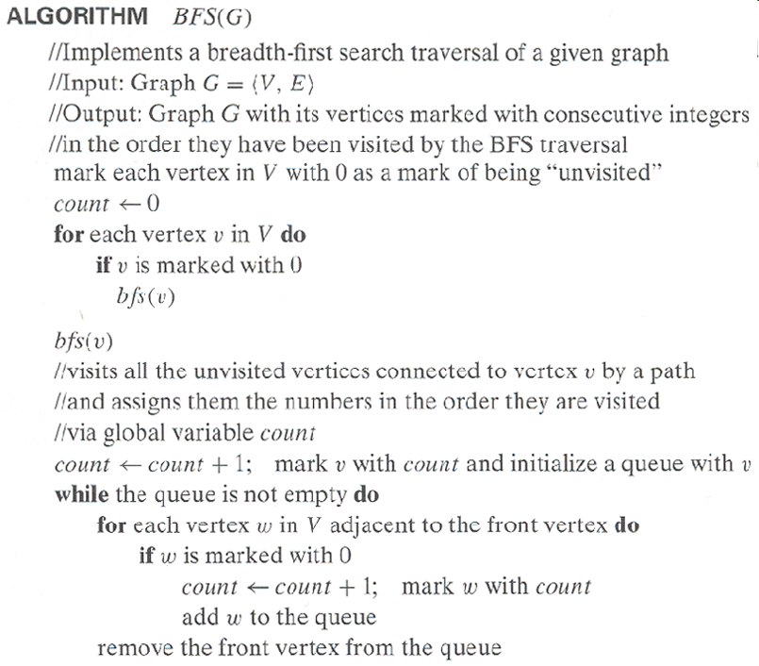
Pseudocode of BFS

Slide 15
Example of BFS traversal of undirected graph
a
b
c
d
a
bef
efg
fg
g
ch
hd
d
e
f
g
h
BFS traversal queue:
BFS tree:
1
2
6
8
a
b
c
d
e
f
g
h
3
4
5
7
Red edges are tree edges and white edges are cross edges.

Slide 16
Notes on BFS
BFS has same efficiency as DFS and can be implemented with graphs represented as:
  adjacency matrices: Θ(|V|²). Why?
  adjacency lists: Θ(|V|+|E|). Why?
Yields single ordering of vertices (order added/deleted from queue is the same)
Applications: same as DFS, but can also find paths from a vertex to all other vertices with the smallest number of edges

